Slide 1

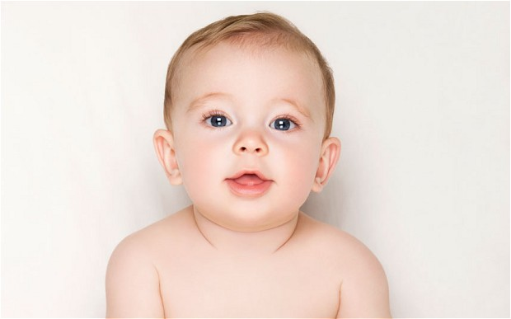
What Can Baby Names Tell Us About Our Narcissism Epidemic?
?
Figure 1: [Baby face] Getty Images. Retrived from The Telegraph
Figure 2: Retrived from Monika Hoyt
Emma(Jielei) Zhu

Slide 2
What is Narcissism?
"My greatest pain in life is that I will never be able to see myself perform live."
–– Kanye West
“People love me. And you know what, I have been very successful. Everybody loves me.”
–– Donald Trump
Notes:
“Extreme selfishness, with a grandiose view of one's own talents and a craving for admiration. ”
(Narcissism. Def. 2 (2015). In Oxford English dictionary online(3rd ed.))

Slide 3
What is Narcissism Epidemic?
According to a study conducted on 15,000 college students¹
narcissism scores were significantly higher in 2000s than in 1980s.
82% of surveyed high school and college students in 2013 reported “being very well off financially” was an important life goal, whereas in the early 70’s, only 45% said so. Scientists termed this an indicator of materialism, which is correlated with narcissism.

Slide 4
Are there trends in baby names that might explain the rise in narcissism for the past decades?

Slide 5
About the Datasets
Two baby name files were downloaded from Kaggle.com (originally from Data.gov)
“Baby names across U.S.”:
Attributes: Name, Year(1914-2014), Gender, Count
Observations: ~200k
“Baby names ordered by state”:
Attributes: Name, Year(1914-2014), Gender, State, Count
Observations: ~600k
(Note: for privacy reasons, all names that occurred less than 5 times were excluded from baby name files)
Yearly population change(1914-2014) downloaded from Census.gov

Slide 6
Hypotheses
Hypothesis 1: Are parents giving their babies unique names?

Slide 7
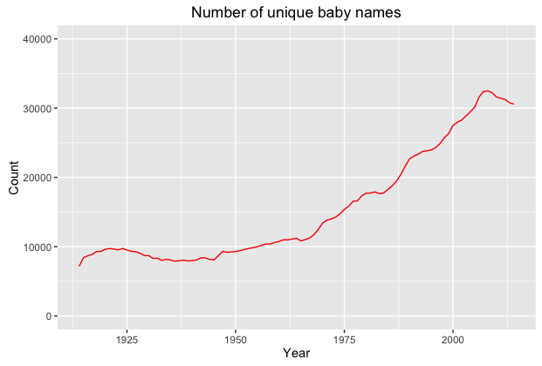
Could the increase in names due to increase in population?

Slide 8
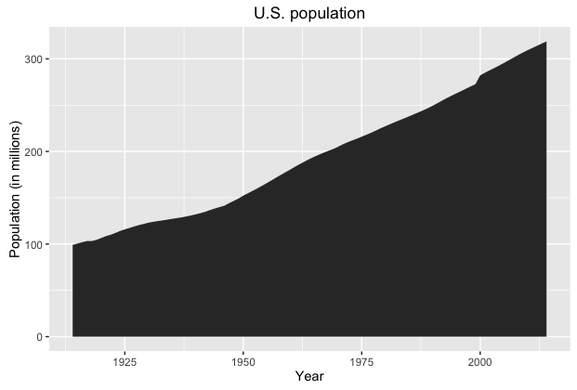

Slide 9
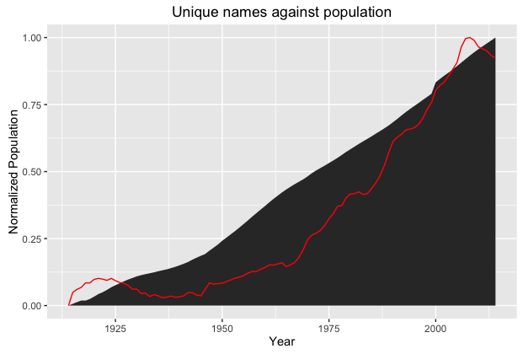

Slide 10
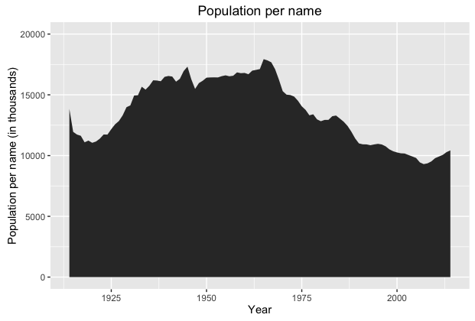
Decreased by 48.2%

Slide 11
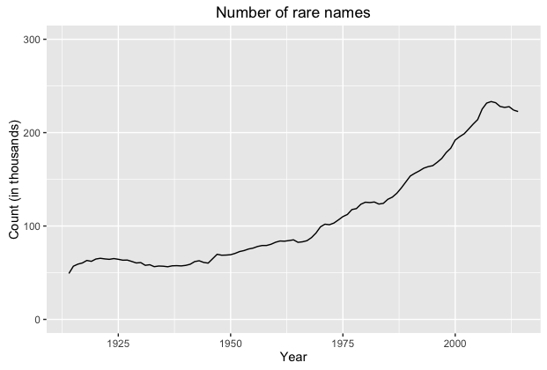

Slide 12
Examples of Rare Names
Noelli | Treyor
Adeleine | Marga
Leiann | Keslie
Nikkolaus | Kahmyah
Benet | Kimmika

Slide 13
Hypotheses
Hypothesis 1: Are parents giving their babies unique names? (yes)
Hypothesis 2: Are parents giving their babies long names?

Slide 14
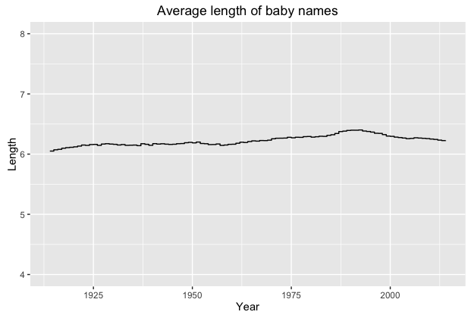
Ashlley | Ashlly | Ashlii | Ashliy | Ashlely | Ashleey | Ashleh | Ashlae | Ashlay | Ashleah

Slide 15
Hypotheses
Hypothesis 1: Are parents giving their babies unique names? (yes)
Hypothesis 2: Are parents giving their babies long names? (no)
Hypothesis 3: Are parents giving their babies names from the opposite gender?

Slide 16
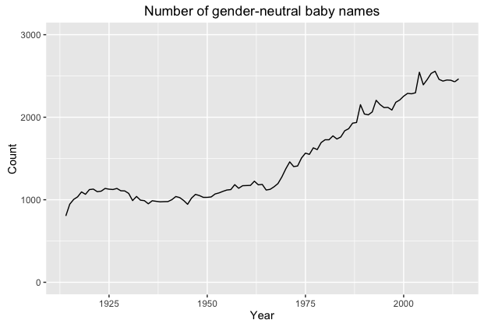

Slide 17
Conclusion
Our narcissism epidemic may be influenced by our parents giving us individualistic names, which are
shared by few other people
traditionally associated with the opposite gender
that might have led us to experience unfounded individualism and self-worth, that eventually leads to narcissism.

Slide 18
Reference
L. M. (2014, May 16). Research says young people today are more narcissistic than ever. Retrieved July 18, 2016, from http://www.abc.net.au/radionational/programs/allinthemind/young-people-today-are-more-narcissistic-than-ever/5457236

